Slide 1
Microorganisms
Are they harmful?
Are they beneficial?
© One Stop Teacher Shop

Slide 2
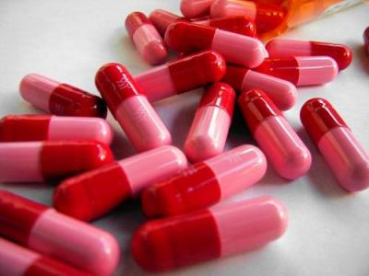
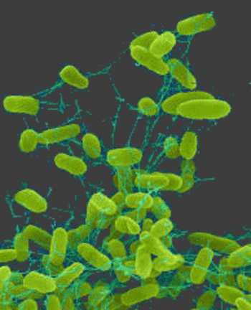
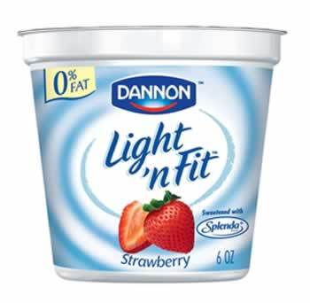
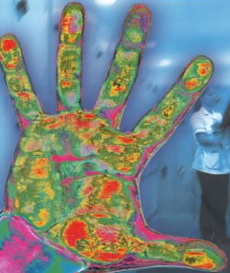
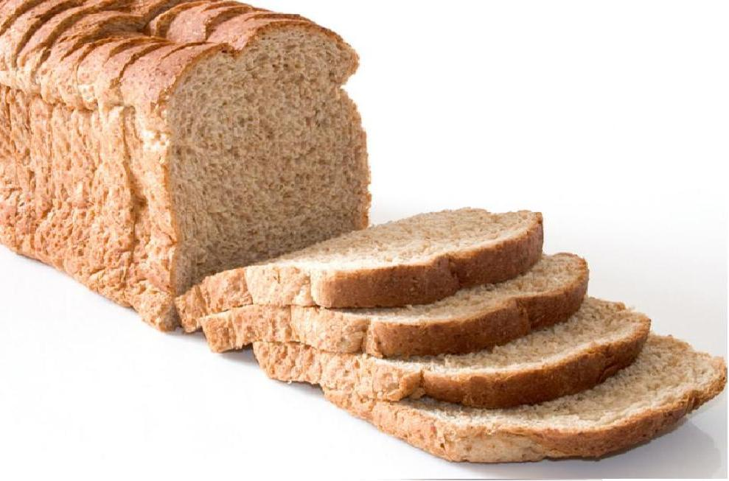
Which are harmful?
Which are beneficial?
If the pink gorilla eats watermelon every night, how much watermelons does he eat?
© One Stop Teacher Shop
Notes:
Ask students “What do these items have to do with microorganisms?” “Which are helpful, and which are harmful?

Slide 3
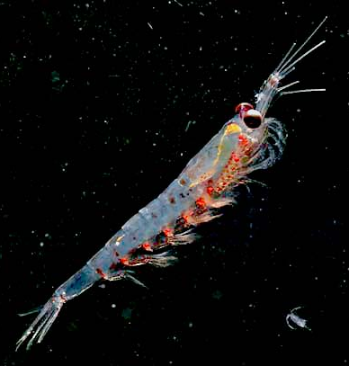
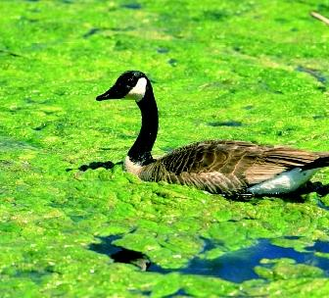
Beneficial Microorganisms
Algae grows on water and produces oxygen
Plankton and Algae provide food for fish
Algae
Plankton under a microscope
© One Stop Teacher Shop

Slide 4
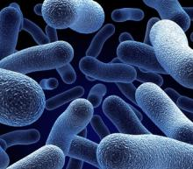
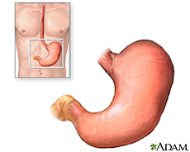
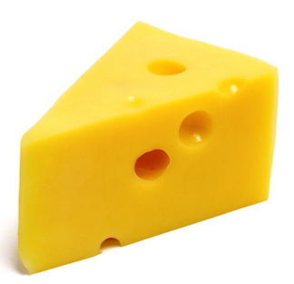
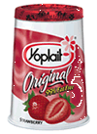
Beneficial Microorganisms
HELPFUL BACTERIA
turns milk into yogurt
produces cheese
are in your stomach to help digest food
© One Stop Teacher Shop

Slide 5
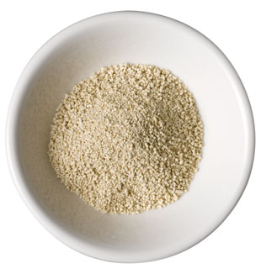
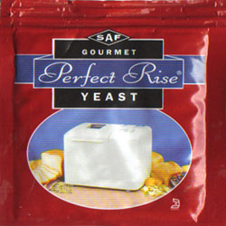
Beneficial Microorganisms
Yeast makes bread, rolls,
and cakes rise.
If the pink gorilla eats watermelon every night, how much watermelons does he eat?
© One Stop Teacher Shop

Slide 6
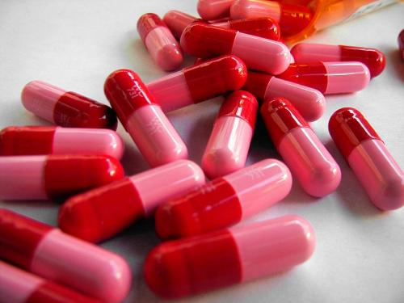
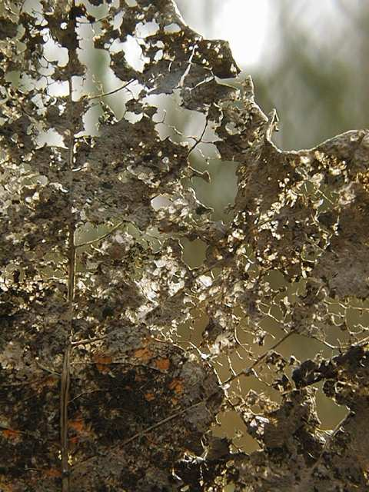
Beneficial Microorganisms
Penicillin (medicine) is made
from mold.
Mold helps dead things
(plants, animals) decay.
© One Stop Teacher Shop

Slide 7
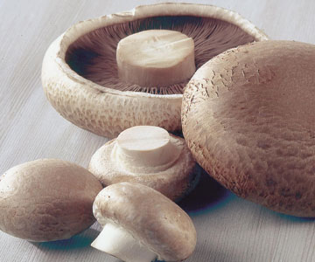
Beneficial Microorganisms
Fungus
Some fungus can provide food.
© One Stop Teacher Shop

Slide 8
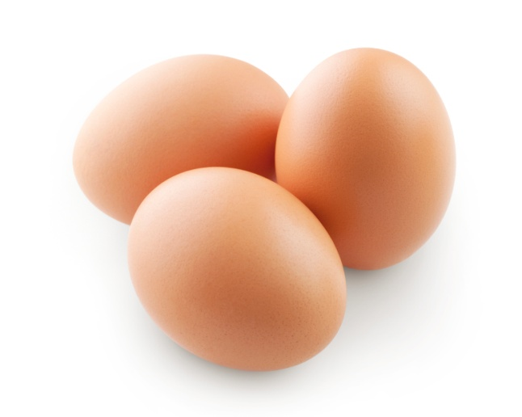
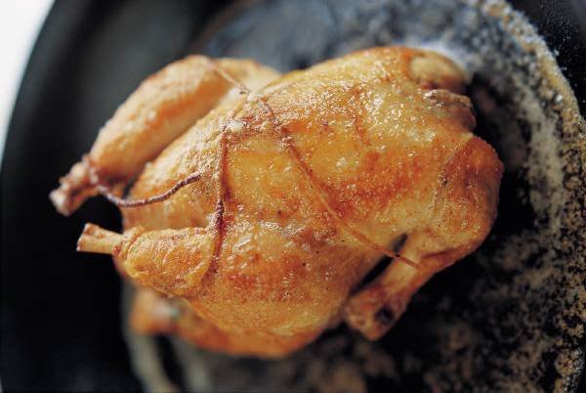
Harmful Microorganisms
Harmful Bacteria
Salmonella and E Coli
    Found on raw chicken and eggs
    Thoroughly COOK all meat to kill bacteria.
If the pink gorilla eats watermelon every night, how much watermelons does he eat?
© One Stop Teacher Shop

Slide 9

Harmful Microorganisms
Harmful Bacteria
Causes strep throat
Harmful Virus
Causes colds
Causes flu
© One Stop Teacher Shop

Slide 10
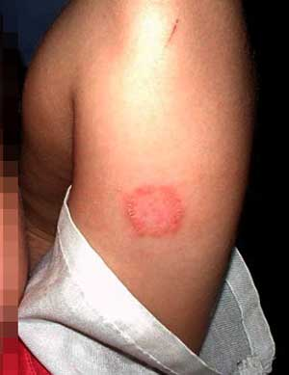
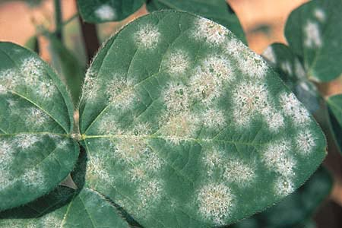
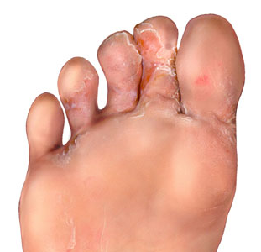
Harmful Microorganisms
Fungus
Can spread through crops and kill them
Can cause skin diseases such as ringworm and athlete’s foot
© One Stop Teacher Shop

Slide 11
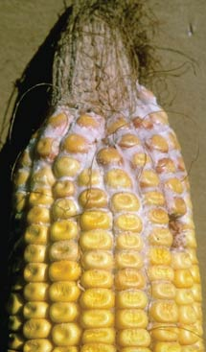
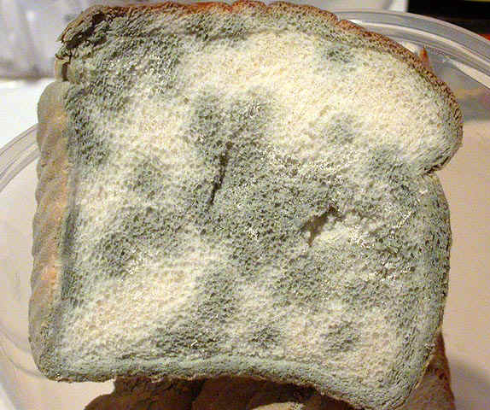
Harmful Microorganisms
Mold
Can spread through crops and kill them
Not healthy for people or animals to digest
© One Stop Teacher Shop

Slide 12
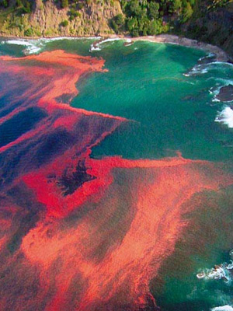
Harmful Microorganisms
Harmful Algae
Red Tide
Algae grows too quickly, covering large amounts of water making it look red (this algae is TOXIC).
This toxic algae is harmful for people, plants and animals
If the pink gorilla eats watermelon every night, how much watermelons does he eat?
© One Stop Teacher Shop

Slide 13
Harmful and Beneficial Microorganisms
Where are they?
THEY ARE
EVERYWHERE!!!!!
In the ocean
Inside your body
In your food
On your body
On plants/animals
In medicine
© One Stop Teacher Shop

Slide 14
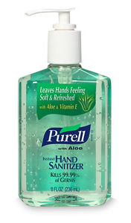
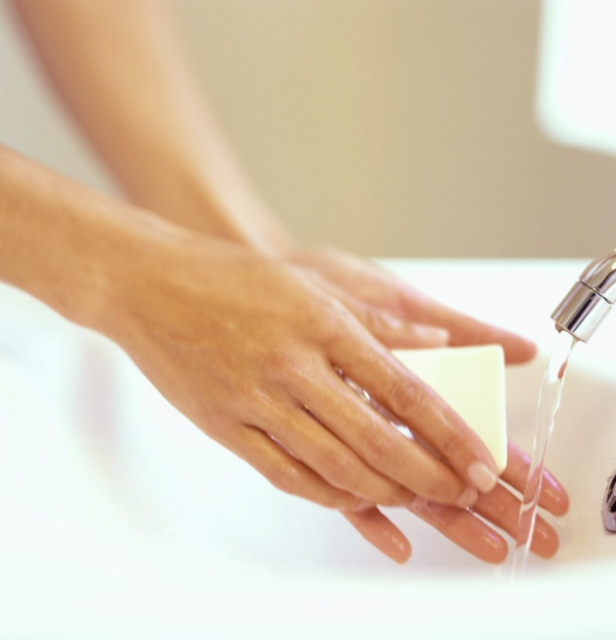
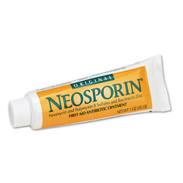
Anti-Bacterial Agents
Hand Sanitizer
Kleenex
HOT water and SOAP
Anti-Bacterial Creams
If the pink gorilla eats watermelon every night, how much watermelons does he eat?
© One Stop Teacher Shop

